Slide 1
Übung 2 Synthese

Slide 2
Synthesis
…
Code
(counter_top.v)
Std. cell library
(library.lib)
Constratints
(constraints.sdc)
Software for Synthesis
(Genus)
Code
elaborate
Netlist with generic Gates/FFs
synthesize
Netlist with Gates and FFs from library
Program (synthesize.tcl)
Netlist
(counter.gtl.v)
Timing report
Quality report

Slide 3
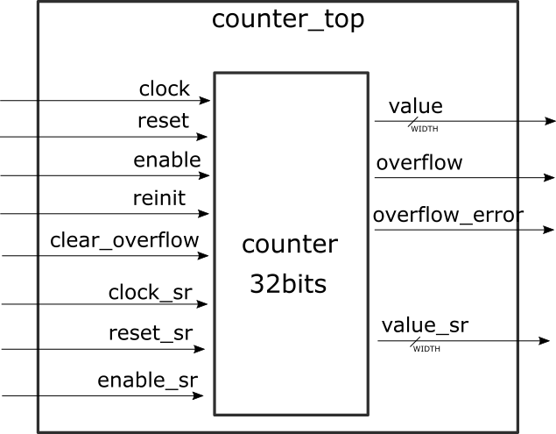
Counter
counter_top contains an instance of the counter, and feed through the counter’s input and outputs

Slide 4
The Cadence tools are usually very complex
We will use only the minimal set of commands required to produce a result
Commands callable from a TCL (tool command language) script
The commands are written in the file called synthesize.tcl

Slide 5
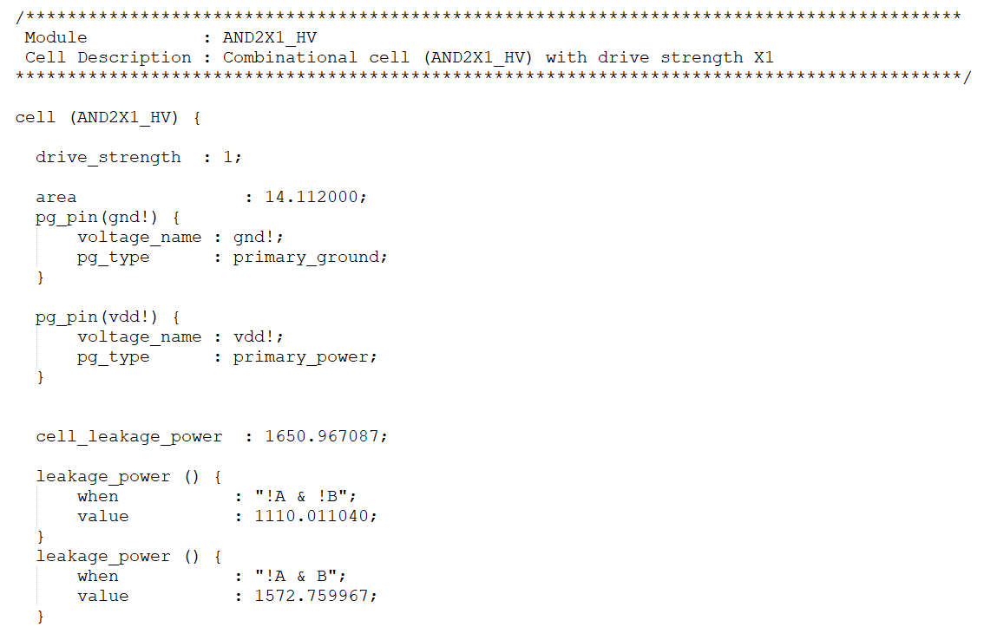
Loading library
To start with synthesis, we have to select a set of logic functions (gates and flipflops) to be used.
The technology kit provides a set of functions, with various timing characterization option.
TCL command: set_db library /path/to/library.lib

Slide 6
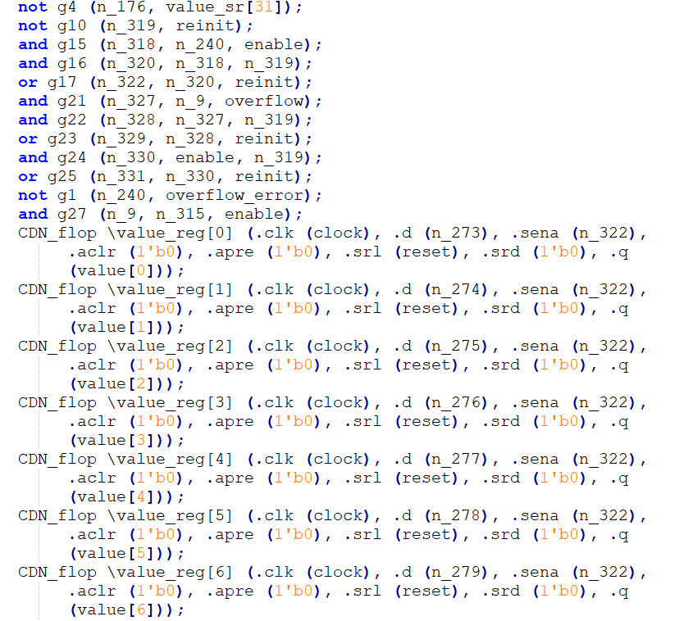
Loading design and elaboration
Loading design
Command: read_hdl -v2001 {counter_top.v ../assignment1/counter.v}
Elaboration
Command: elaborate
Elaboration is the process of implementing HDL description as a netlist with generic gates and flipflops

Slide 7
Constraints
Defining the constraints is done by calling a set of commands, using a standard called SDC (Synopsis Design Constraints).
SDC commands are supported by tools from Cadence, Synopsis and the newest Xilinx Vivado Suite, which makes design constraining easy to learn and reuse among various technologies.
constraints.sdc

Slide 8
Constraints
Defining the clocks is the first step when writing a constraints file. Mostly three parameters are required:
A clock frequency or waveform (if the clock is not symetrical)
A target wire to apply it to
A name to identify the clock. It is usually set to the name of the wire, for clarity
Commands in constraints.sdc
create_clock -name clock -period 1 [get_port clock]
Further commands:
set_clock_uncertainty 0.1 -setup clock
(reduces setup slack by 0.1 ns)
set_clock_uncertainty 0.1 -hold clock
(reduces setup slack by 0.1 ns)
set_output_delay -clock clock 0.5 [get_ports {value*}]
Load command in synthesize.tcl: read_sdc constraints.sdc

Slide 9
Configuring timing output
Timing groups are a feature of the tool to group the logic paths depending on their types and help make timing analysis clearer
Input to register (I2C)
Register to output (C2O)
Register to Register (C2C)
Example:
set all_regs [all des seqs -clock clock]
define_cost_group -name C2C
path_group -from $all_regs -to $all_regs -group C2C -name C2C

Slide 10
Synthesis
Commands for synthesis:
synthesize -to_mapped -effort medium
Incremental optimization:
synthesize -to_mapped -incr -effort medium
Command for writing the output netlist: write_hdl
Command for writing of timing output: report timing

Slide 11
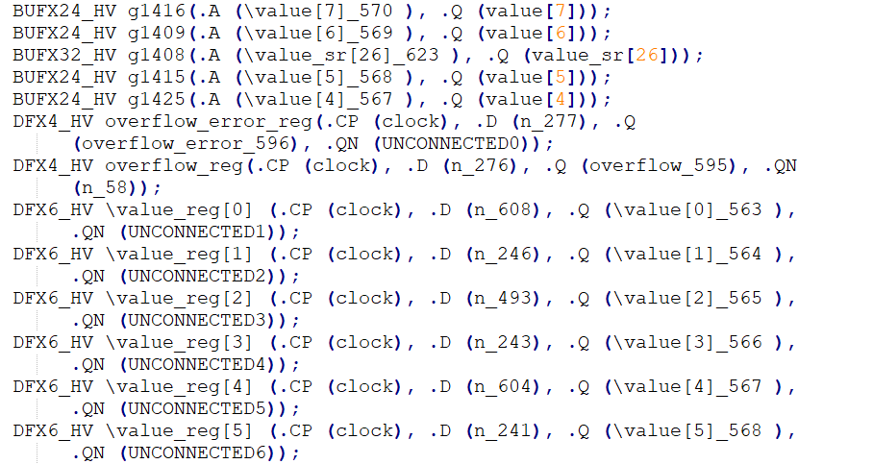
Netlist
…

Slide 12
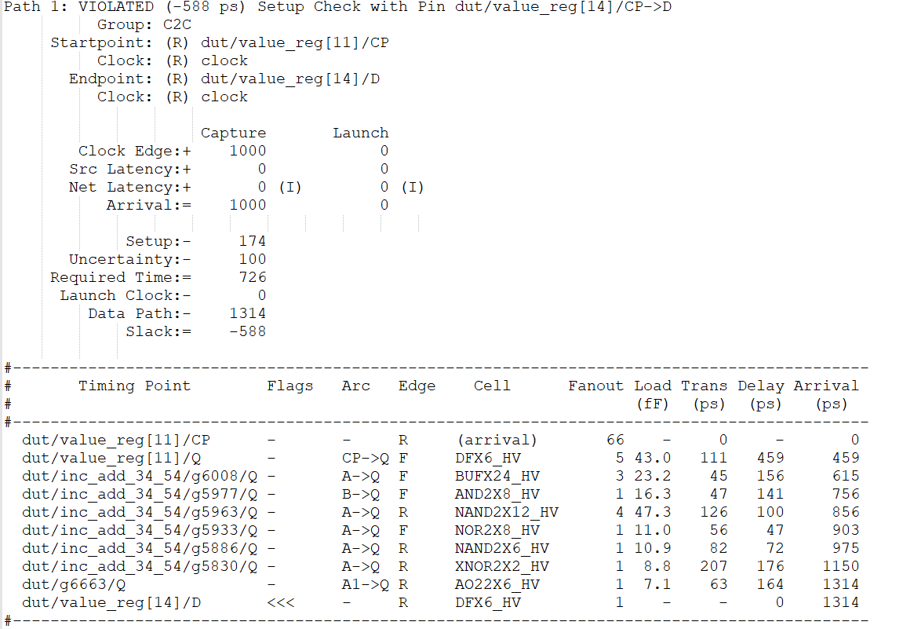
Timing report
FF1
FF2
Q1
D2
L1
L2

